Slide 1

“News Media Application ” Task - 1
SUNSTONE

Slide 2

SUNSTONE
Project Name : “ News Media Application ”
In today's fast-paced digital age, staying informed is essential. Our News Media Application is designed to revolutionize the way users access and consume news. With a user-friendly interface, real-time updates, personalized content recommendations, and a seamless multimedia experience, our application aims to cater to the diverse information needs of users, fostering informed citizenship and promoting media literacy.
S.NO | LMS Username | Name | Batch
1 | @irudhayaajay1105 | Irudhayaajay | 12
2 | @kuralarasan4720 | Kuralarasan | 12
3 | @ajay1301 | Ajay | 12
4 | @gokul2707 | Gokul | 12

Slide 3
Task-1
Creation of SRS and Github
Create SRS : “News Media Application ”
Creation & A Set-up of Github account
SUNSTONE
Creation & Hands – on to various commands of Git Bash
Evaluation Metric:
100% Completion of the above tasks
Learning Outcome
Get to know about different lifesycle models.
Understanding importance and how to create an SRS.
Knowing varous commands of Github.
Understanding agile and scrum management techniques for efficient for product development.

Slide 4
Step-Wise Description
SUNSTONE
Project Initiation
Market Research
Design and Prototyping
Development
Personalization and User Profiles
Testing and Quality Assurance
Security and Compliance
Launch and Marketing
Summary of your task
The task involves creating a News Media Application, a comprehensive project with the aim of providing a user-friendly, personalized, and multimedia-rich platform for news consumption. This project entails multiple steps, including market research, design, development, personalization, testing, security implementation, and a strategic launch with effective marketing. The ultimate goal is to deliver a reliable and engaging application that not only keeps users informed but also empowers them with tailored news content while ensuring data security and compliance with privacy regulations.

Slide 5
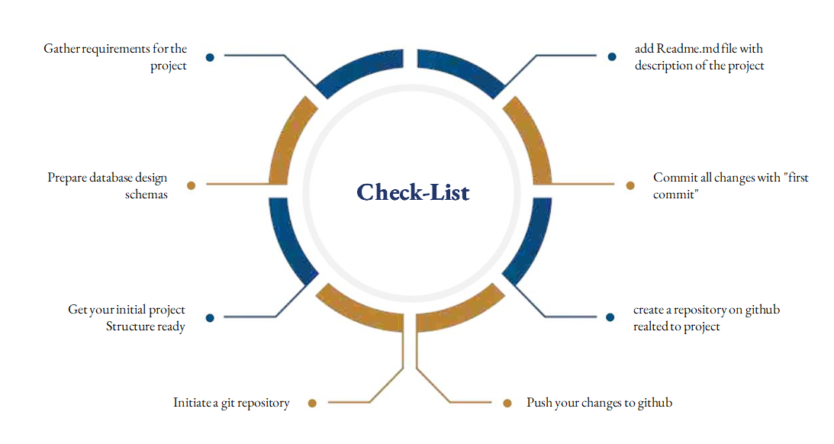
SUNSTONE
Assesment Parameter

Slide 6
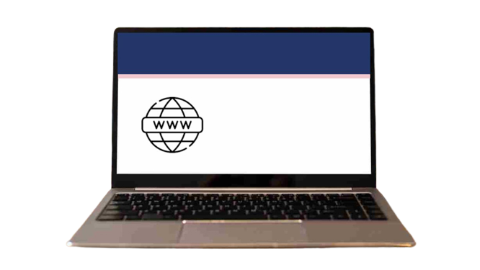
SUNSTONE
Submission Github
https://github.com/Ajay0678/NM-AIT-GROUP12

Slide 7


SUNSTONE

